Slide 1
A Summary: State Health Improvement Plans Across the U.S.
6/26/2023 Public Health Committee Meeting
Shane Roberts, DrPH, MPH
Assistant Director, Office of Public Health Practice
Zahra Alaali, MPH
Coordinator, NYS Prevention Agenda
June 26, 2023

Slide 2
State Health Improvement Plans (SHIPs)
The Prevention Agenda 2019-2024 is New York State's health improvement plan:
State Health Assessment (SHA)/State Health Improvement Plan (SHIP) is a framework for states to engage in a collaborative effort to assess and address health priorities through marshalling a broad coalition of stakeholders and resources in implementing evidence-based and data-driven interventions and developing measurable and achievable health objectives and indicators.
SHA and SHIP, and a health department’s organizational strategic plan, are prerequisites for PHAB Accreditation.
ASTHO maintains comprehensive guidance on the SHA/SHIP framework, the NYS Prevention Agenda Dashboards are held up as an example within that guidance.

Slide 3
SHIP Process
PHAB describes the state health improvement process as follows:
The state health department’s SHIP addresses the needs of all citizens in the state.
The SHIP is a long-term, systematic plan to address issues identified in the SHA.
The purpose of the SHIP is to describe how the health department and the community it serves will work together to improve the health of the population of the jurisdiction that the health department serves.
The community, stakeholders, and partners can use a SHIP to set priorities, direct the use of resources, and develop and implement projects, programs, and policies.
The plan is more than the roles and responsibilities of the health department alone
The plan’s development must include participation of broad set of community stakeholders and partners.
The planning and implementation process is community-driven.
The plan reflects the results of a collaborative planning process that includes significant involvement by a variety of community sectors.

Slide 4
Healthy People 2030
“Healthy People 2030 sets data-driven national objectives to improve health and well-being over the next decade”
Vision
A society in which all people can achieve their full potential for health and well-being across the lifespan.
Mission
To promote, strengthen, and evaluate the nation’s efforts to improve the health and well-being of all people.

Slide 5
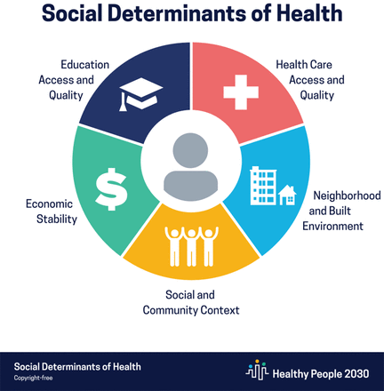
Healthy People 2030
Five categories of objectives:
Health Conditions
Health Behaviors
Populations
Settings and Systems
Social Determinants of Health
Three priority areas:
Health Equity
Social Determinants of Health
Health Literacy

Slide 6
SHIP Analysis
51 SHIPs reviewed (50 states and Washington D.C.)
Preliminary thematic analysis conducted to identify patterns among SHIP priorities
SHIPs assessed for goal statement, priorities, guiding frameworks, and innovation

Slide 7
SHIP Mission/Goal Statements
 | All Californians should have optimal health. Being the healthiest state in the nation means that Californians throughout the lifespan—from our children to our seniors—are healthy.
 | All people in Vermont have a fair and just opportunity to be healthy and to live in healthy communities
 | All Mississippians living healthier, longer lives due to a thriving public-health effort supported by active and committed citizens and organizations.

Slide 8
Guiding Principles and Frameworks
Mobilizing for Action through Planning and Partnerships (MAPP)
Collective Impact Model
Social Determinants of Health
Healthy People 2030
Health Equity

Slide 9
Priorities
253 priorities across 51 plans
~47 unique priorities
28 priorities included in 2 or more SHIPs
19 priorities unique to a single plan

Slide 10
Priorities
Priorities | n
Mental Health, Mental Well-being, Suicide Prevention | 33
Maternal and Child Health, Early Prenatal Care, Infant Mortality, Child Development, Strong Start for Children | 22
Healthcare Access, Rural & Urban Underserved Health, Uninsured, Primary Care Clinicians | 21
Chronic Disease | 19
Substance Misuse | 19
Healthy Weight, Nutrition, Physical Activity, Healthy Food, Obesity & Diabetes | 17
Social Determinants of Health, Health in All Policies, Community conditions, Health Disparities | 12
Health Equity, Health Literacy, Institutional bias, Health Education | 9
Whole Person Care, Patient-centered Care, Wellness | 9
Adverse Childhood Experiences, Resilient Children, Early Childhood Development | 8
Mental health was a top priority for states, with 65% including it in their SHIPs
Nearly all SHIPs included health equity as a central guiding principal, with 9 separating it out as an individual priority
Among the top 10 most selected priorities, 50% were health factors, and 50% were health outcomes

Slide 11
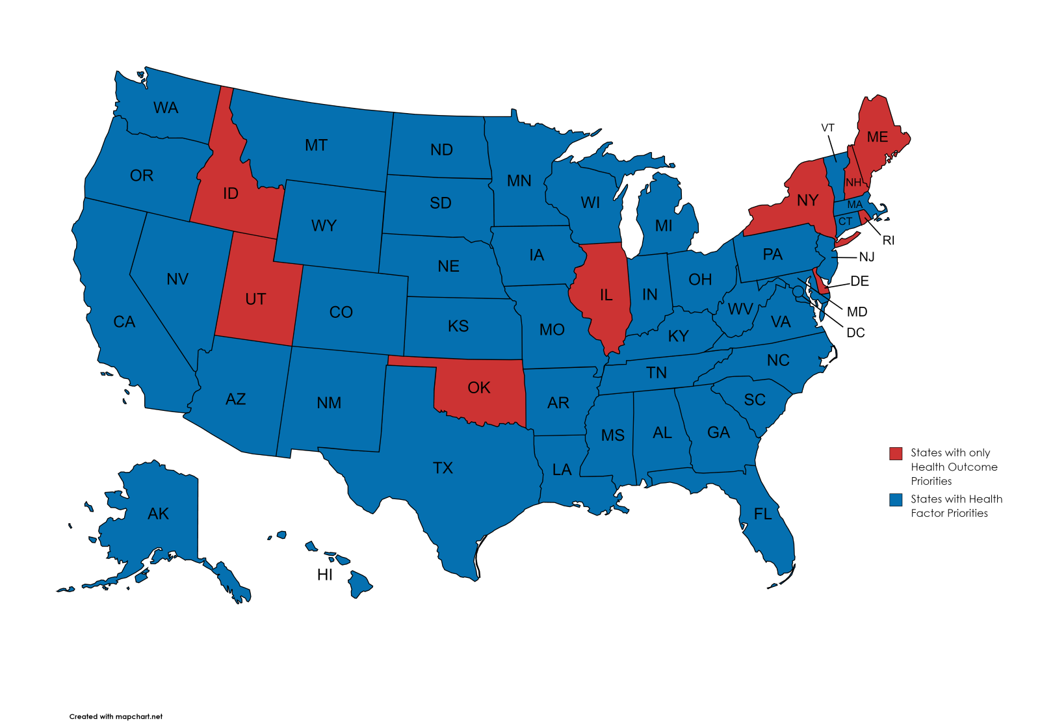
Priorities
SHIPS ranged in their emphasis with some focused primarily on health outcomes, and others on health factors. Some states offered a hybrid model of priorities consisting of health factors and outcomes.
82% of SHIPS offered at least one priority that was health factor/SDoH focused
9 of 51 SHIPs use exclusive health outcome or disease model, including New York

Slide 12
Priorities
New Hampshire – Health Outcome Focus
Tobacco
Obesity and Diabetes
Heart Disease and Stroke
Healthy Mothers and Babies
Cancer Prevention
Asthma
Injury Prevention
Infectious Disease
Emergency Preparedness
Misuse of Alcohol and Drugs

Slide 13
Priorities
Connecticut – Health Factor Focus
Access to Health Care
Economic Stability
Healthy Food and Housing
Community Strength and Resilience

Slide 14
Priorities
Ohio – Hybrid Health Outcome/Factor Focus
Health Factor Priorities:
Community conditions
Health behaviors
Access to care
Health outcome priorities:
Mental health and addiction
Chronic disease
Maternal and infant health

Slide 15
Summary
The State Health Improvement Plan model encourages a multisector collaboration of invested stakeholders in drafting a plan that incorporates the Social Determinants of Health as a core guiding framework in setting forth a long-term, systematic plan for addressing identified health priorities.
A significant majority (82%) of states have adopted plans that either wholly or in-part consist of priorities that address health factors.
New York is one of nine states using primarily a health outcome/disease-based model.
NYSDOH recommends:
The Prevention Agenda, New York State’s Health Improvement Plan, be a bold and innovative agenda, grounded in health equity and built upon a framework that addresses the social factors that determine health status, and includes meaningful community engagement.
The Ad Hoc Committee to Support the New York State Prevention Agenda be given a charge to advise the Department on how to ensure that health equity and the social factors determining health status are foundational to the 2025-2030 NYS Prevention Agenda priorities.

